Slide 1
Neuroplasticity
Neural Pathways
Connections between neurons
Can grow stronger or weaker
All events change your brain
Neuroplasticity creates new memories
Your brain changes continually

Slide 2
Implicit Memory
Procedural memories
Priming
Conditioning
Notes:
Can you populate the table like this:
First on each click each type comes up in the right order: beta, aplha etc..
Then on the clicks after gamma, the Frequencies come in right order, one each click

Slide 3
Implicit Memory
Spaced practice is more effective than massed practice
You learn more per hour, if you space it out
You need time for memory consolidation
You become the average of the 5 people you spend most time with

Slide 4


Explicit and Long-Term Memory
Exercise
Meditation
Stress
Improper nutrition
Notes:
Can you populate the table like this:
First on each click each type comes up in the right order: beta, aplha etc..
Then on the clicks after gamma, the Frequencies come in right order, one each click

Slide 5
Explicit and Long-Term Memory
Hippocampus
Detects novel events, places and stimuli
Short-Term ➔ Long-Term
Not needed for creating implicit memories

Slide 6
Explicit and Long-Term Memory
Reference memory
Put in context
Memories are interconnected
Mere repetition is ineffective
Use deeper information processing

Slide 7
Working and Short-Term Memory
WM stores info for ~15 sec
Distractions destroy productivity
11 min work
25 min disctraction
~70% is wasted on distractions

Slide 8
Working and Short-Term Memory
Turn of notifications
Do the important thing first
Keep a distraction log

Slide 9
Working and Short-Term Memory
Better WM ➔ better resilience against distractions
Improve WM:
Dopamine & Noradrenaline
Meditation (long term)

Slide 10
Emotional Memory
Emotions strengthen associated memories
Attach personal and emotional meaning

Slide 11
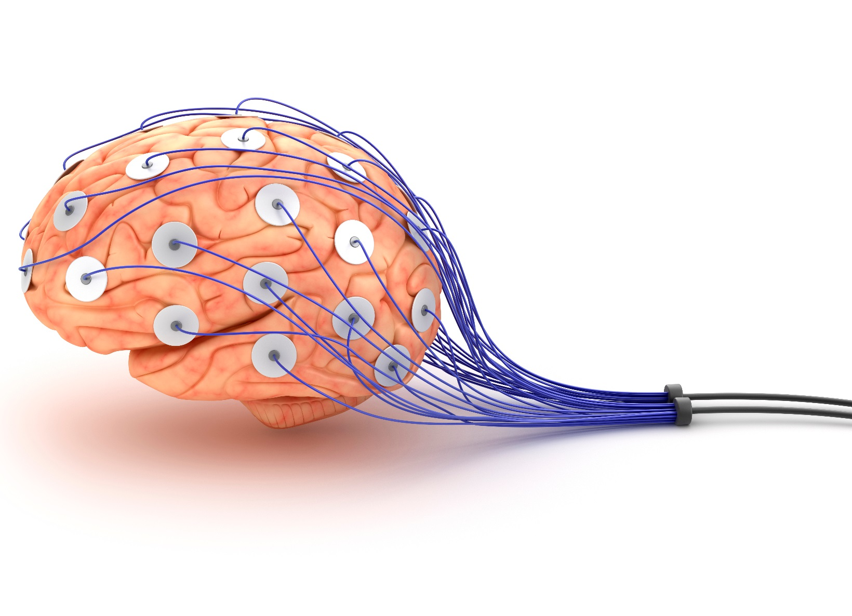
Brain Waves
Type | Hertz
Beta | 15-30
Alpha | 9-14
Theta | 5-8
Delta | 1-4
Gamma | 30-100
Notes:
Can you populate the table like this:
First on each click each type comes up in the right order: beta, aplha etc..
Then on the clicks after gamma, the Frequencies come in right order, one each click

Slide 12
Brain Waves
Induce alpha state
Consume L-Theanine
Green tea ~ 8 mg
Black tea ~ 24 mg
Focus on your breath (relax)

Slide 13
Dopamine
Excitement
Drive
Motivation
More focus
Better working memory
Helps memory formation

Slide 14
Dopamine
Divide your goals into small tasks
Music
Familiar music
Cycle your playlists

Slide 15
Noradrenaline
Motivation
Focus
Working memory
Memory formation
Notes:
Can you populate the table like this:
First on each click each type comes up in the right order: beta, aplha etc..
Then on the clicks after gamma, the Frequencies come in right order, one each click

Slide 16
Noradrenaline
Goal
Deadlines
sub goals
➔ many & short
Notes:
Can you populate the table like this:
First on each click each type comes up in the right order: beta, aplha etc..
Then on the clicks after gamma, the Frequencies come in right order, one each click

Slide 17
Noradrenaline
Cold showers 14˚C / 57˚F
Noradrenaline +530%
Dopamine +250%
Notes:
Can you populate the table like this:
First on each click each type comes up in the right order: beta, aplha etc..
Then on the clicks after gamma, the Frequencies come in right order, one each click

Slide 18
Noradrenaline
Tyrosine
Phenylalanine
Curcumin
Turmeric
Notes:
Can you populate the table like this:
First on each click each type comes up in the right order: beta, aplha etc..
Then on the clicks after gamma, the Frequencies come in right order, one each click

Slide 19
Serotonin
Sunlight
Tryptophan
Carbohydrates
Curcumin

Slide 20
Endorphins
Flow state
Neutralizes super oxides

Slide 21
Endorphins
Vary exercise & push limits
Practice intermittent fasting
Eat spicy foods & cacao
Laugh
Get a massage & accupuncture
Notes:
Can you populate the table like this:
First on each click each type comes up in the right order: beta, aplha etc..
Then on the clicks after gamma, the Frequencies come in right order, one each click

Slide 22
Nitric Oxide
Exercise
Eat nitrate rich foods
Supplements
L-Citruline
L-Arginine
Grape seed extract
Resveratrol
Notes:
Can you populate the table like this:
First on each click each type comes up in the right order: beta, aplha etc..
Then on the clicks after gamma, the Frequencies come in right order, one each click

Slide 23
BDNF
Brain Derived Neurotropic Factor
“Growth hormone
for your brain”

Slide 24
BDNF
Exercise
Get sunlight
Practice intermittent fasting
Consume green tea & curcumin
Notes:
Can you populate the table like this:
First on each click each type comes up in the right order: beta, aplha etc..
Then on the clicks after gamma, the Frequencies come in right order, one each click

Slide 25
Cortisol
Avoid negativity
Meditate
Get sunlight
Take vitamin D-3
Reduce caffeine intake
Optimize your sleep
Notes:
Can you populate the table like this:
First on each click each type comes up in the right order: beta, aplha etc..
Then on the clicks after gamma, the Frequencies come in right order, one each click

